Slide 1
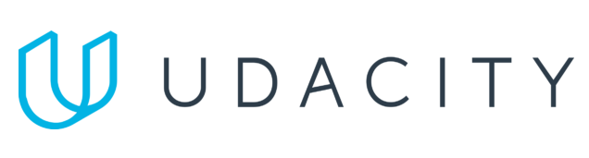
Data Lake Value Proposition
Medical Data Processing Company
HoanNT19
Udacity IPS Version 1.0

Slide 2
Agenda
What is a Data Lake
Components of a Data Lake
Data Lake vs Data Warehouse
Business Value of Data Lake Solution
Proposed Data Lake Architecture for Medical Data Processing system
Udacity IPS Ver. 1 2/2020

Slide 3
What is a Data Lake
Executive summary
Data Lake is a central place where we can bring together data, Machine Learning, and Analytics
Data can store data of any type, including unstructured, semi-structured, and structured
Can handle scaling of any size
Breaks data silos
Schema on Read
Enables Analytics Use Cases

Slide 4
Components of Data Lake
There 2 main components from ingesting to governing data.
Ingestion - tools to ingest data in Data Lake
Processing - tools to process the data in Data Lake
Storage - Store the data at scale in a data lake. Orchestrations - Design and automate ETL workflows
Governance - Broad term, including management of the data lake of the whole. Security - Secure your data using encryption at rest and in transit. Authentication, authorization, accounting, and data protection are key features.
Quality - Ensuring that the data in the data lake is most up to date and consistent. Catalog - A centralized metadata repository about the actual data set with descriptions, purpose, schema, and lineage information. This helps break data silos
Audit - Track data access from every application and data resource
Lineage - This handles the data's origin. Where the data moves to and what happens to it.

Slide 5
Data Lake vs Data Warehouse
While a data lake holds data of all structure types, including raw and unprocessed data, a data warehouse stores data that has been treated and transformed with a specific purpose in mind, which can then be used to source analytic or operational reporting.

Slide 6
Data Warehouse
Data Lake
Refined/structured/relational data
Schema designed at the beginning
Used by mainly business analysts
Used for historical analytics, visualizations, BI
Collects similar data from multiple resources
Unstructured, unrefined, not relational data
schema designed at the end
Use by data scientists and data developers, business analysts
Used for predictive analytics, machine learning
Connecting various types of data from a wide variety of sources
Udacity IPS Ver. 1 2/2020

Slide 7
Business Value of Data Lake
Companies are seeing the need to scale data, both in type as well as size. And because that data may not be structured and will also be used in a wide variety of ways, data lakes can be very effective to support this
Companies are looking for ways to store, organize and analyze a LARGE amount of enterprise data.
Companies are struggling with data silos. With each organization/department within the company having its own data and no cross-organization visibility
Access to data for the engineering and analytics team is hard, time-consuming process

Slide 8
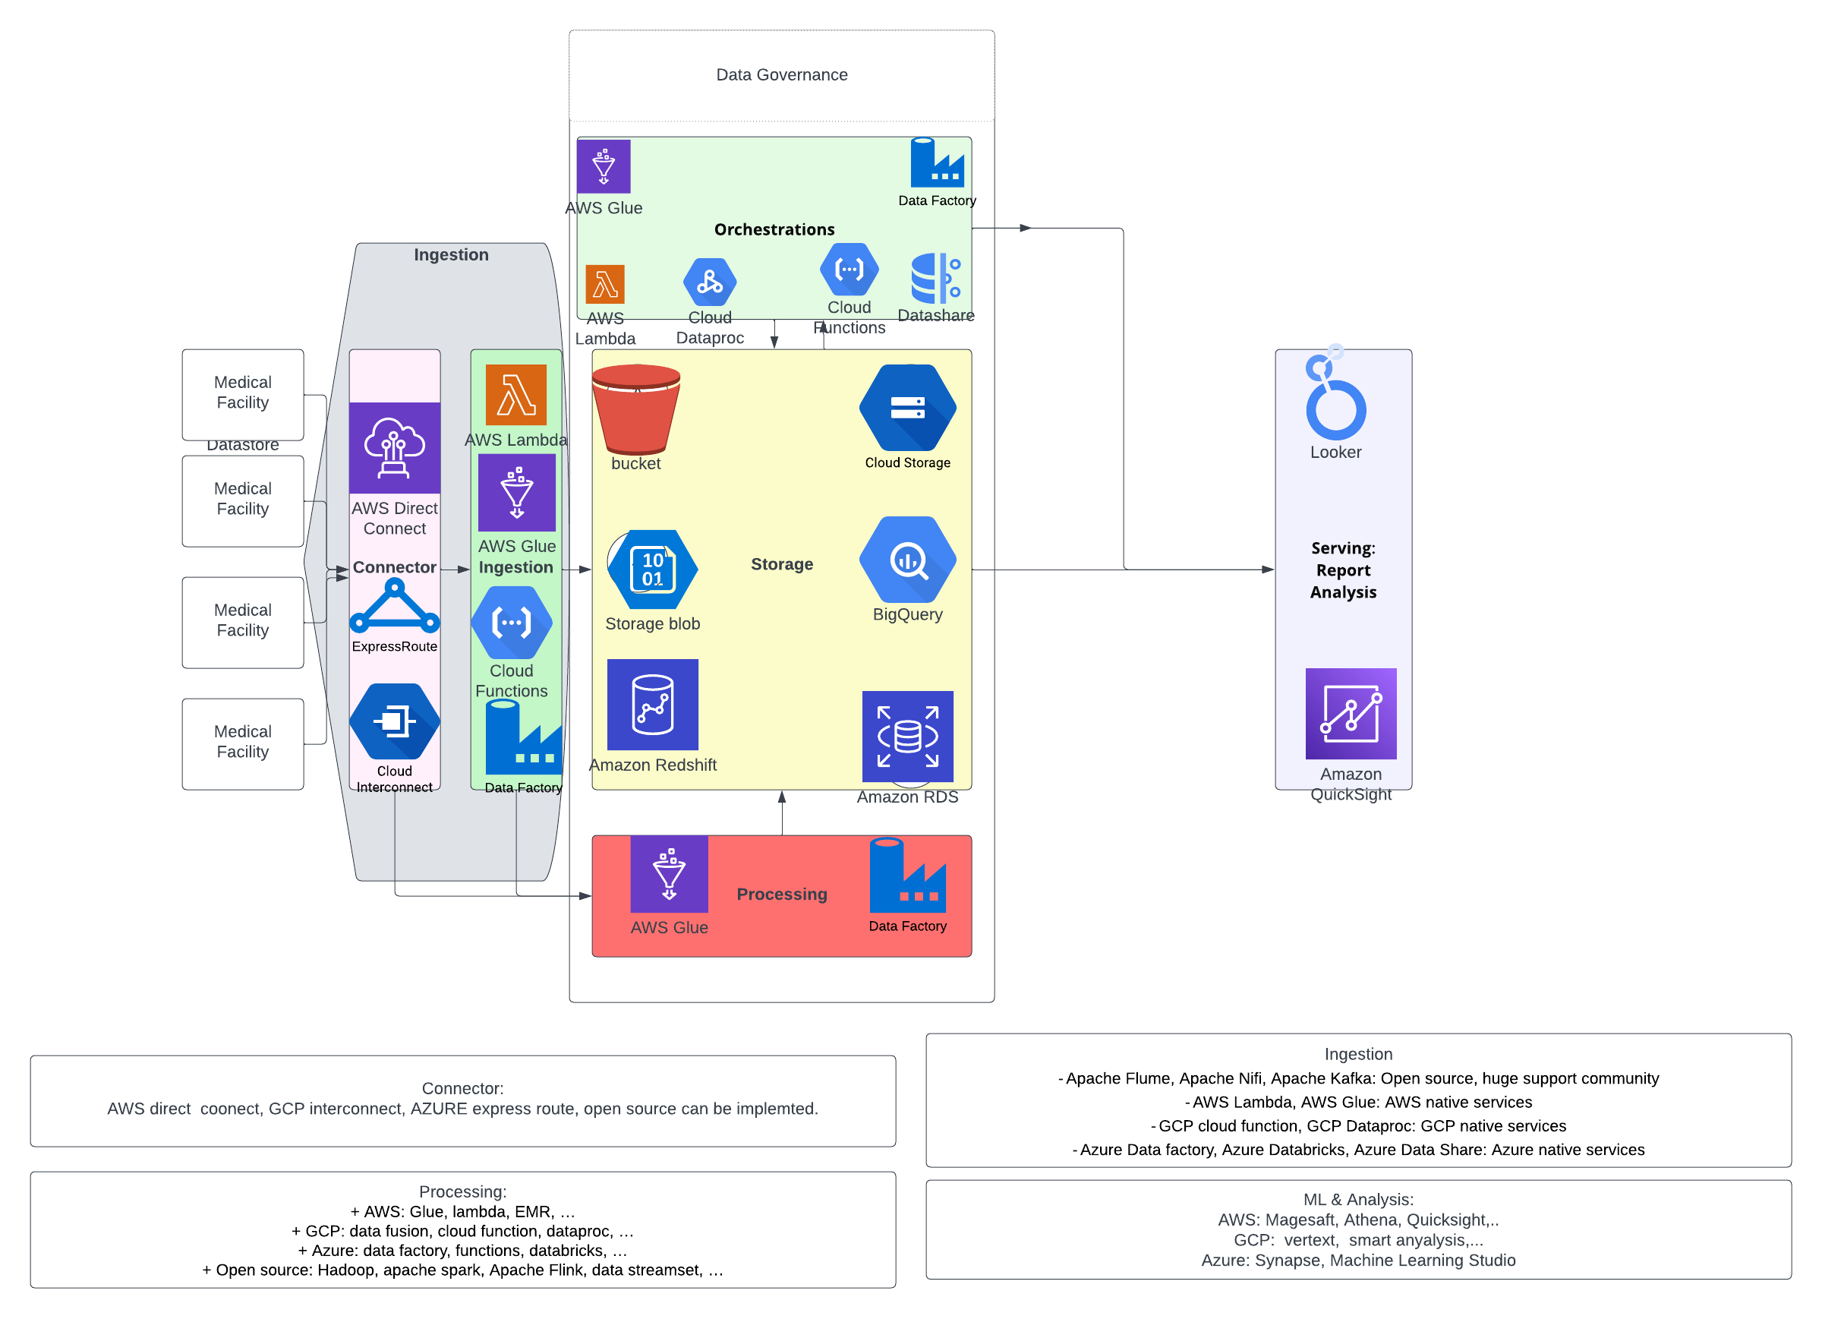
Data Lake Architecture

Slide 9
THANK YOU
Udacity IPS Version 1.0

